Slide 1
Kenneth Hanson
Introduction to
Molecular Photophysics

Slide 2
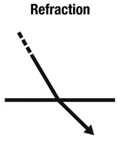
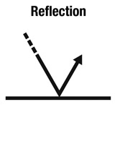
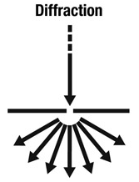
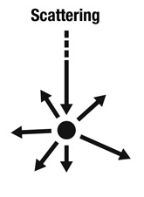
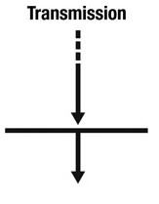
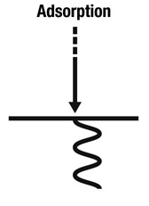
Interaction of Incident Light with Matter

Slide 3
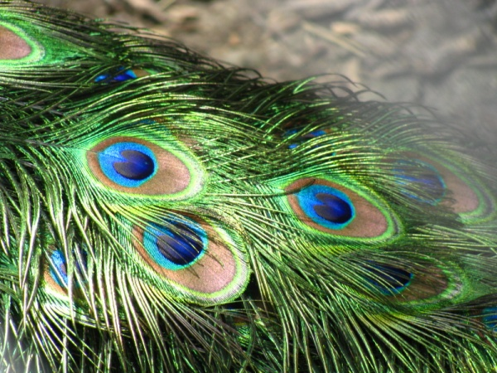
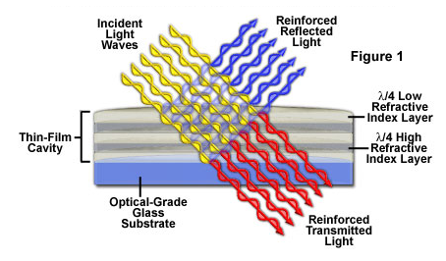
Interaction of Incident Light with Matter
Rainbows
Mirage
Moon Light
Most solids
Two-slit exp
Holograms
Shadow Blur
Sand in Water
Sunsets

Slide 4
Interaction of Incident Light with Matter
Rainbows
Mirage
Moon Light
Most solids
Two-slit exp
Holograms
Shadow Blur
Sand in Water
Sunsets
UV-Vis
Fluorometry
TRE, TA

Slide 5
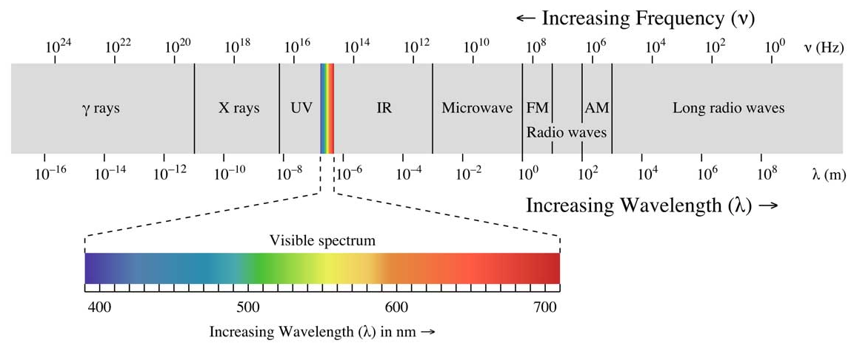
Interaction of Light with Matter
Narrowing our focus
Absorp./Trans.
Visible spectrum
Electronic Transitions- electrons excited from one energy level to another.
Atomic
Molecular
Materials
Solids
Light (hν)
Sample

Slide 6
Hydrogen Absorption
hν
Energy
hν
Ground State
Excited State

Slide 7
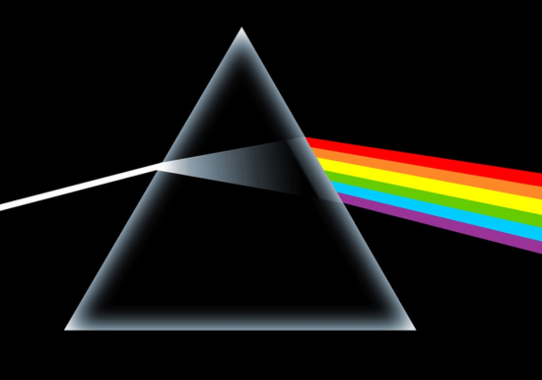
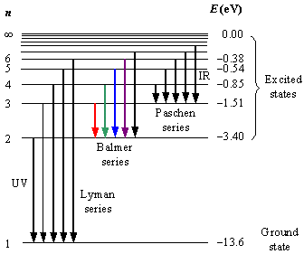
Hydrogen Absorption
H
H
H
H
H
H
H
“white” light source
Hydrogen Sample
Prism
Line Spectrum
Rydberg Formula

Slide 8
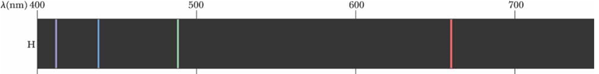
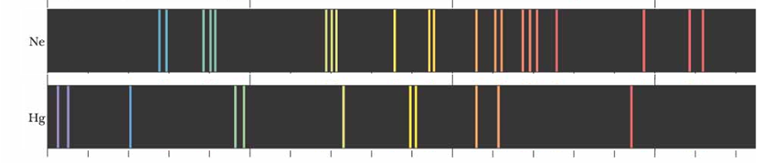
Increasing Complexity
1 e⁻
10 e⁻
80 e⁻
Atomic Transitions
(movement of electrons)
+
Molecular/Materials Transitions
(movement of electron density)
250 e⁻

Slide 9
Transitions
hν
hν
Atomic Transitions
hν
hν
Molecular Transitions

Slide 10
Types of Molecular Transitions
σ - σ*
λ_{max} < 150 nm
π - π*
λ_{max} 200 - 800 nm
n - π*
λ_{max} 150 - 300 nm

Slide 11
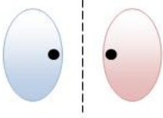

Types of Molecular Transitions
Ozone!
σ - σ*
λ_{max} < 250 nm
High energy photons
    methane = 125 nm
    ethane = 135 nm
Antibonding
hν
Bonding
Ground State
Excited State

Slide 12
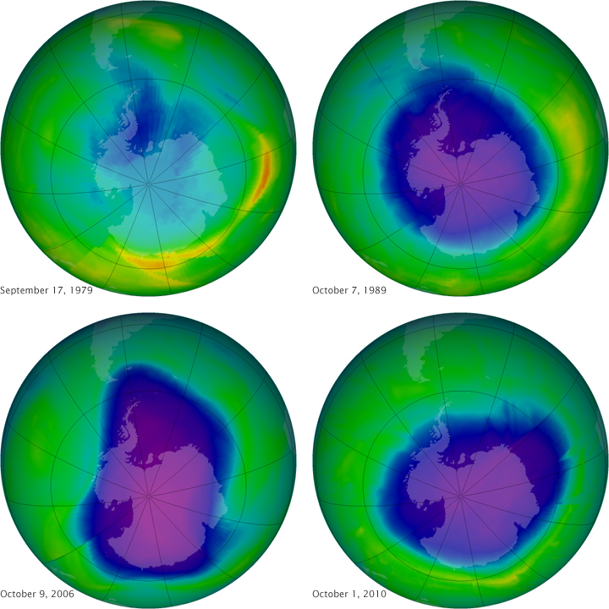
σ - σ* Reactions
1950s-70s CFCs wide spread use in refrigerators.
1960s and 70s scientists observe a depletion in the ozone layer.
Mid 70s scientists propose a catalytic mechanism for the
hν
CCl₂F₂ → Cl• + •CClF₂
O₃ + Cl• → ClO• + O₂
ClO• + O → O₂ + Cl•
1996- CFC production ends in US and Europe
2010-for the first time in decades the ozone concentration is increasing

Slide 13
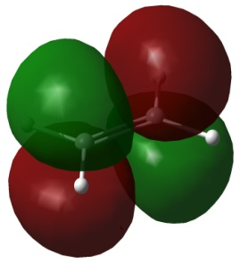
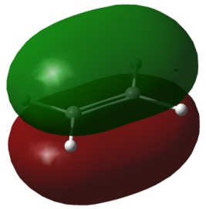
Types of Molecular Transitions
π - π*
λ_{max} 200 - 800 nm
Visible photons
    benzene = 260 nm
    tetracene = 500 nm
Antibonding
hν
Bonding
Ground State
Excited State

Slide 14


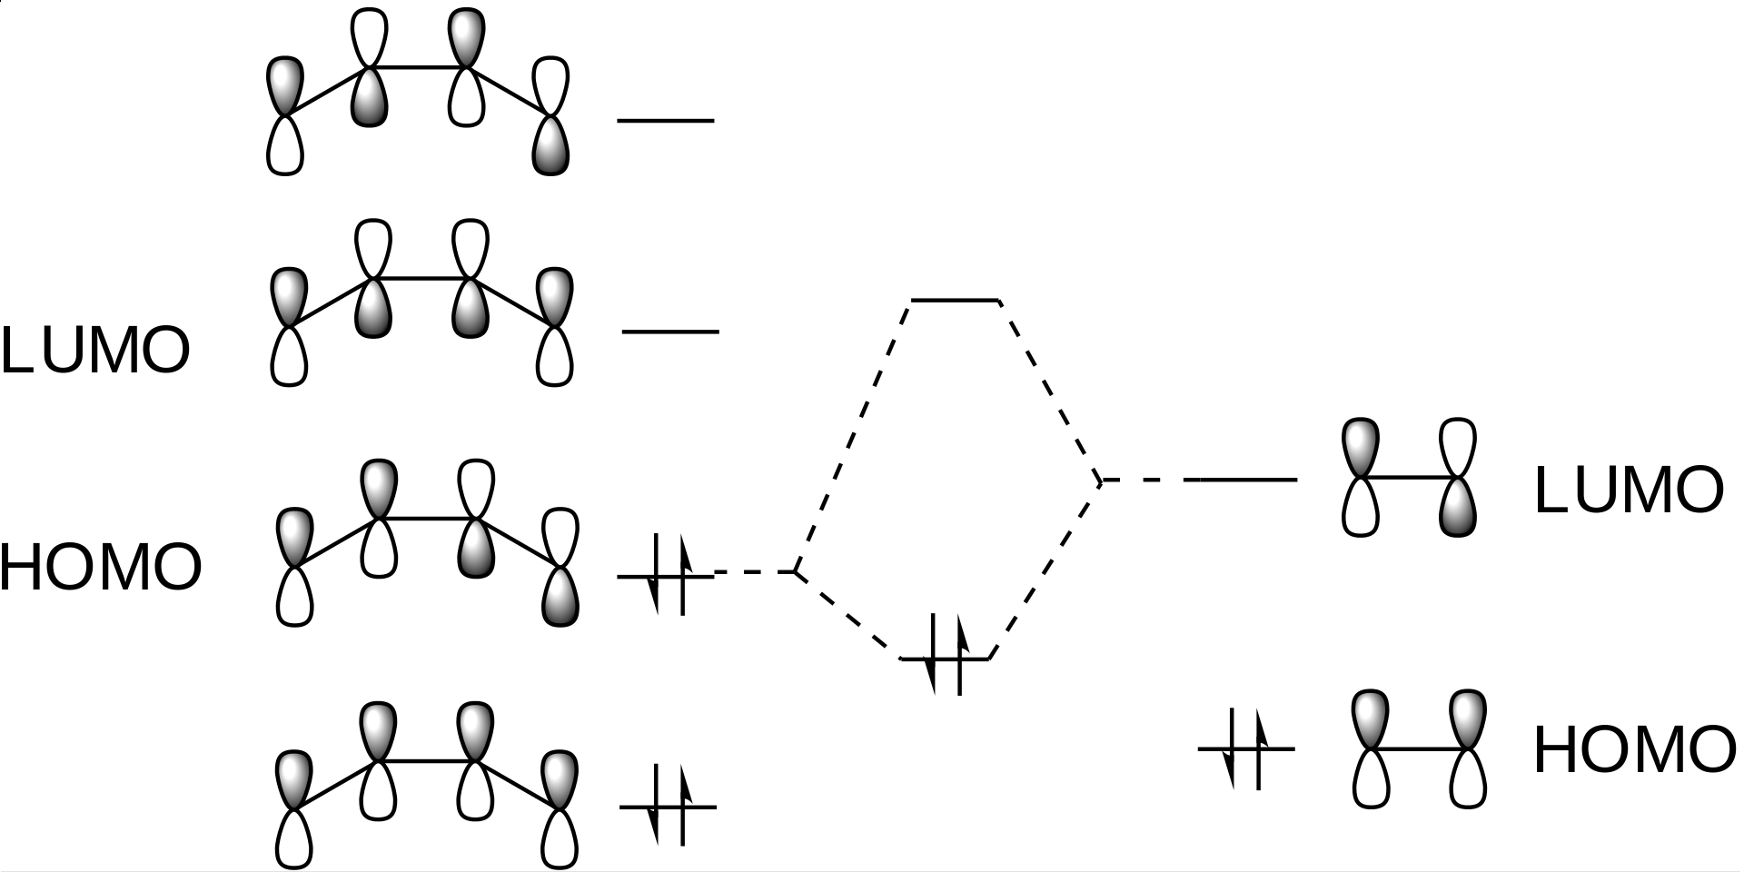
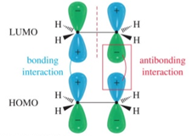
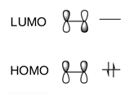


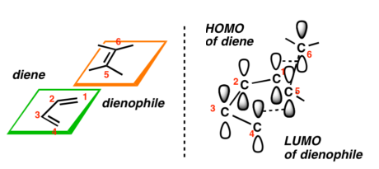
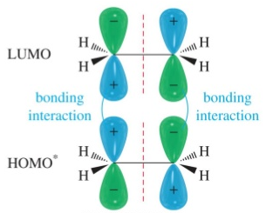

π - π* Reactions
[4 + 2] Cycloaddition (Diels Alder)
[2 + 2] Cycloaddition
hν
hν

Slide 15
Types of Molecular Transitions
n - π*
λ_{max} 150 - 300 nm
Visible photons
    acetone = 280 nm
    pyridine = 270 nm
Antibonding
hν
Non-Bonding
Ground State
Excited State

Slide 16
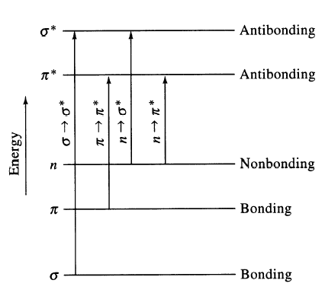
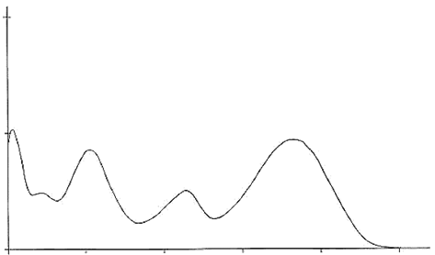
Types of Molecular Transitions
σ - σ*
λ_{max} < 150 nm
π - π*
λ_{max} 200 - 800 nm
σ - σ*
π - π*
Absorption
n - π*
λ_{max} 150 - 300 nm
n - π*
100
200
300
400
500
Wavelength (nm)

Slide 17
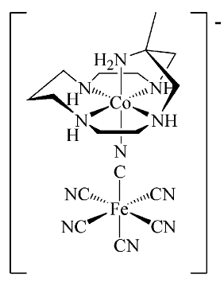
Adding in Transition Metals
[Co(H₂O)₆]²⁺
Metal Centered (MC)
λ_{max} 200 –800 nm
MnO₄⁻
MLCT
λ_{max} 300 –1000 nm
LMCT
λ_{max} 300 –1000 nm
MMCT
λ_{max} 300 –800 nm

Slide 18
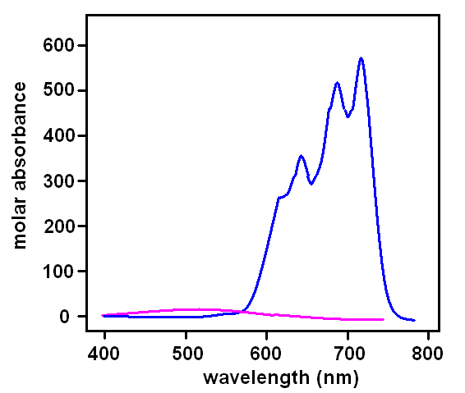
Types of Molecular Transitions
Metal Centered (MC)
d-d transitions
λ_{max} 200 – 800 nm
e_{g}
t_{2g}
[CoCl₄]²⁻
M
M + L
3d and 4d transition metals (+ ligands)
Relatively weak (0-1000 M⁻¹cm⁻¹)
Early structural determination
[Co(H₂O)₆]²⁺

Slide 19
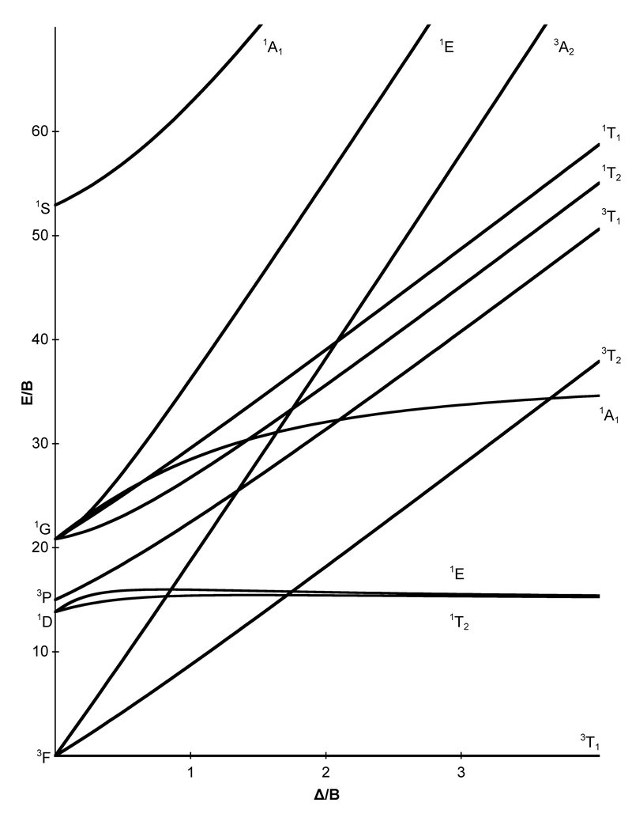
Tanabe-Sugano Diagrams
d³
Useful for:
Electronic States
Relative Energies
Ligand Field Affects
Optical Transitions
Spin Multiplicities
High-Spin to Low-Spin Transitions
Estimate Δ_{o}

Slide 20
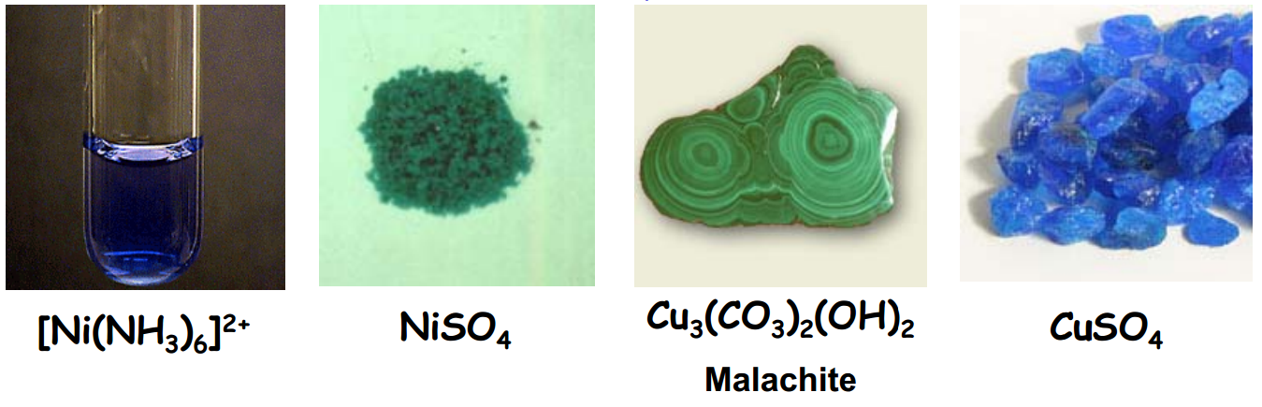
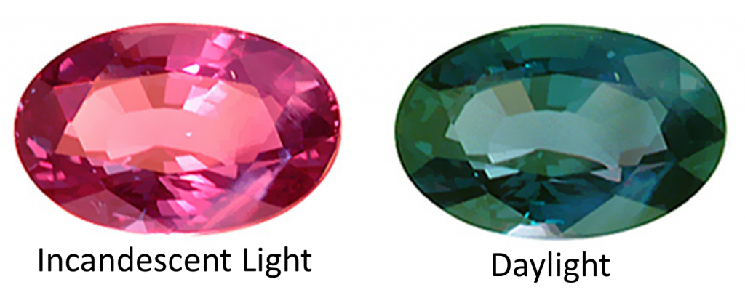
Colors of Metal Ions
Alexandrite
Cr³⁺ doped
BeAl₂O₄

Slide 21
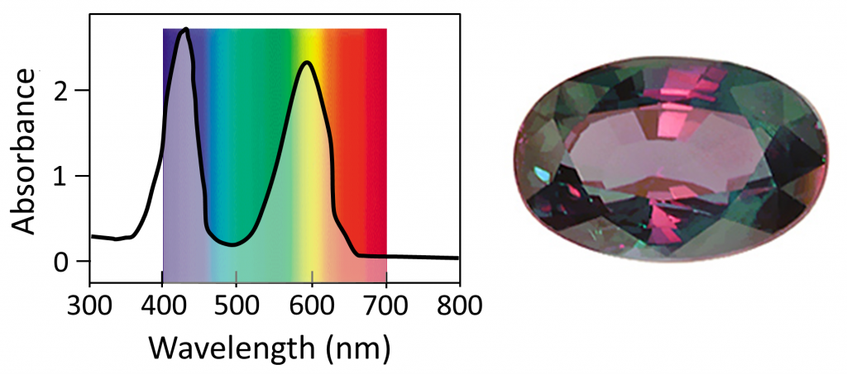
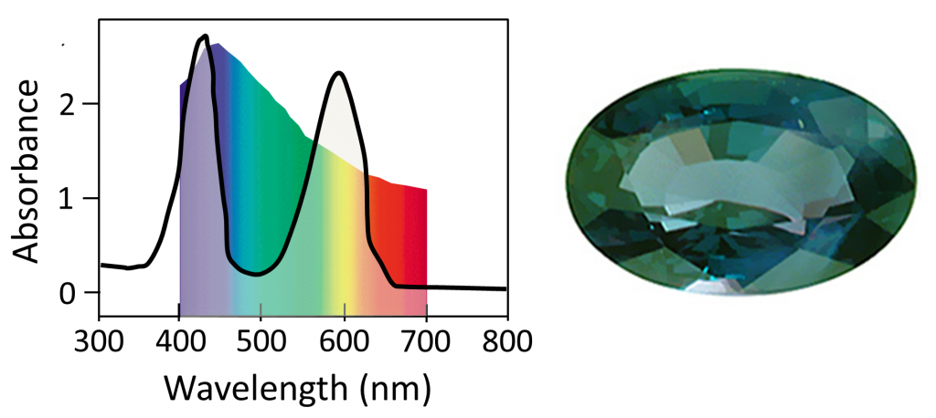
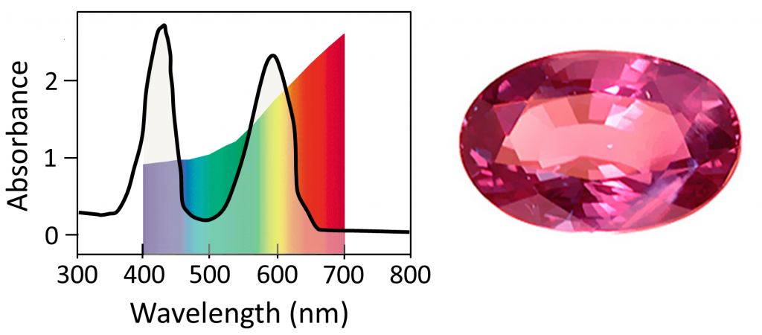
Colors of Metal Ions
Cr³⁺ doped
BeAl₂O₄
Uniform White Light
~400 nm = ⁴A_{2g} to ⁴T_{1g}
~600 nm = ⁴A_{2g} to ⁴T_{2g}
Sunlight
Candle Light
http://www.chemistry-blog.com/2013/08/22/alexandrite-effect-not-all-white-light-is-created-equal/

Slide 22
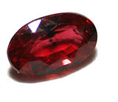
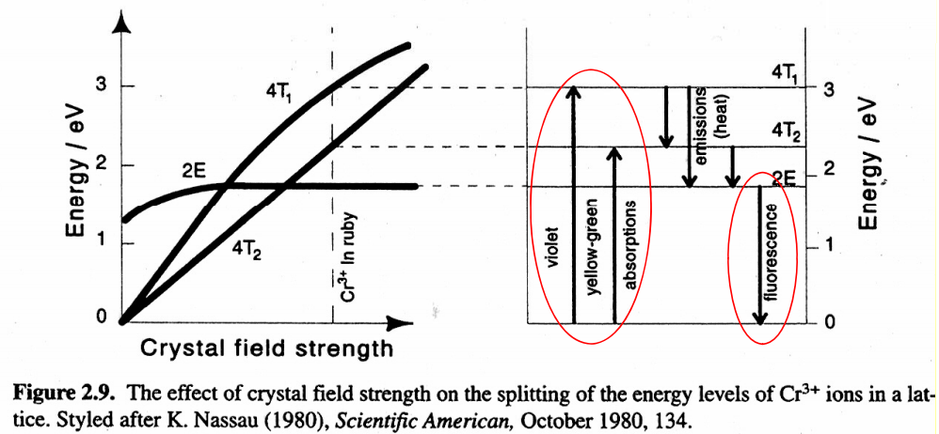
Colors of Metal Ions
Ruby
~1% Cr³⁺ doped Al₂O₃
Absorbs yellow-green region
Emits red
Most expensive ruby (1.6 cm³) = $6.7 million
Al₂O₃ (1.5 cm³) = ~$500

Slide 23
Types of Molecular Transitions
Metal-to-Ligand Charge Transfer (MLCT)
λ_{max} 300 – 1000 nm
e_{g}
e⁻
π*
hν
t_{2g}
π - π*
M
M + L
L
MLCT
  Low-lying empty ligand orbital
  Low oxidation state metal (electron rich)
  High d orbital energy

Slide 24
Types of Molecular Transitions
Ligand-to-Metal Charge Transfer (LMCT)
λ_{max} 300 – 1000 nm
e⁻
e_{g}
Mn-O₄⁻
O²⁻ (π) → Mn⁷⁺
Purple
t_{2g}
π
e⁻
Cd-S
S²⁻ (π) → Cd²⁺
Yellow
M
M + L
L
  Ligand with high E lone pairs (S or Se)
  Metal with low-lying empty orbitals

Slide 25
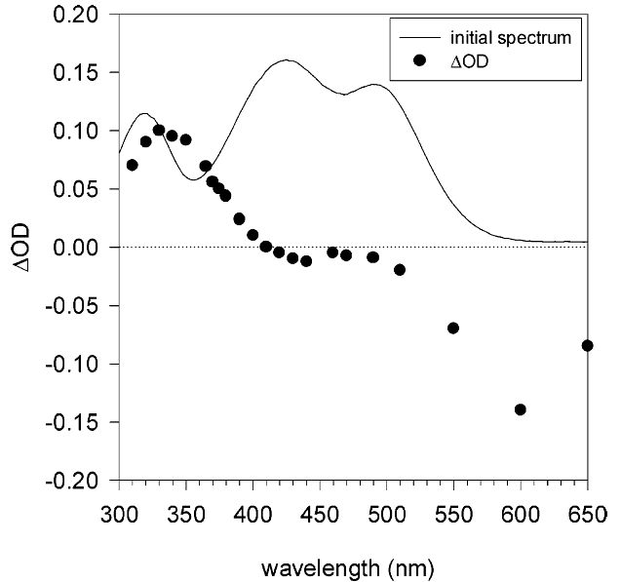
Types of Molecular Transitions
Metal-to-Metal Charge Transfer (MMCT)
λ_{max} 300 – 800 nm
III
e⁻
II
MMCT
e_{g}
e_{g}
t_{2g}
M¹
M²
t_{2g}
M¹ + L
M² + L

Slide 26
Types of Molecular Transitions
π∗
e⁻
e⁻
e_{g}
e⁻
e_{g}
M¹
t_{2g}
M²
t_{2g}
MLCT
π
MC
Absorption
LMCT
M¹ + M² + L
MMCT
300
400
500
600
700
Wavelength (nm)

Slide 27
Complete Diagram
Transitions
σ - σ*
E₂
σ - π*
n - π*
π - π*
Transitions
n - π*
Electronic
n - σ*
Energy
E₁
MLCT
MC
MLCT
LMCT
MMCT
E₀

Slide 28
Complete Diagram
Transitions
σ - σ*
E₂
σ - π*
n - π*
π - π*
Transitions
n - π*
Electronic
n - σ*
Energy
E₁
Vibrational
MLCT
Rotational
MC
MLCT
LMCT
MMCT
E₀

Slide 29
Complete Diagram
Jablonski Diagram
S₂
E₂
S₁
n - π*
Energy
Transitions
Electronic
Energy
E₁
Vibrational
S₀
MLCT
Rotational
E₀

Slide 30
Complete Diagram
Jablonski Diagram
S₂
S₁
Second Excited State (S₂)
Energy
First Excited State (S₁)
S₀
Excitation
Internal Conversion
Fluorescence
Ground
State (S₀)
Non-radiative decay

Slide 31
Complete Diagram
Jablonski Diagram
S₂
hν
S₁
Energy
Ground State
S₀
Singlet Excited State
S₁
S₀
Excitation
Internal Conversion
Fluorescence
Non-radiative decay

Slide 32
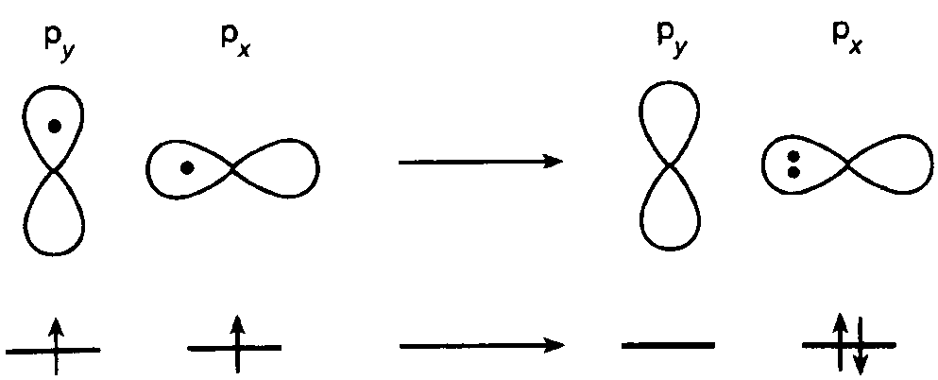
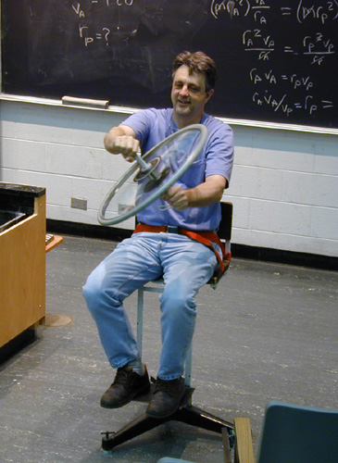
Spin-Orbit Coupling
Quantum Numbers
n = Principal
l = Angular
m_{l} = Magnetic
m_{s} = Electron spin
Heavy Atoms
Pt, Ir, I...
Rotating Chair and Bicycle Wheel
Nicholas J. Turro, Principles of Molecular Photochemistry

Slide 33
Jablonski Diagram
S₂
Excitation
Internal Conversion
Fluorescence
Non-radiative decay
Intersystem Crossing
Phosphorescence
S₁
T₂
Energy
T₁
S₀

Slide 34
Jablonski Diagram of Anthracene
Nicholas J. Turro, Principles of Molecular Photochemistry

Slide 35
Other Processes
S₂
S₁
T₂
Energy
T₁
Electron transfer
TICT
ESIPT
Photochemical
  Reactions
S₀
Excitation
Internal Conversion
Fluorescence
Non-radiative decay
Intersystem Crossing
Phosphorescence

Slide 36
Excited State Electron Transfer
e⁻
hν
e⁻
+
A
Ru^{III}(bpy)₃ + A⁻
e⁻
hν
+
+
Ru^{II}(bpy)₃
[Ru^{II}(bpy)₃]*
A
Ru^{III}(bpy)₃
A⁻

Slide 37
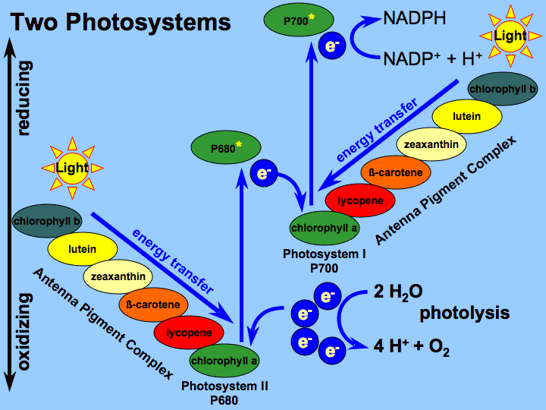
Excited State Electron Transfer
Photosynthesis

Slide 38
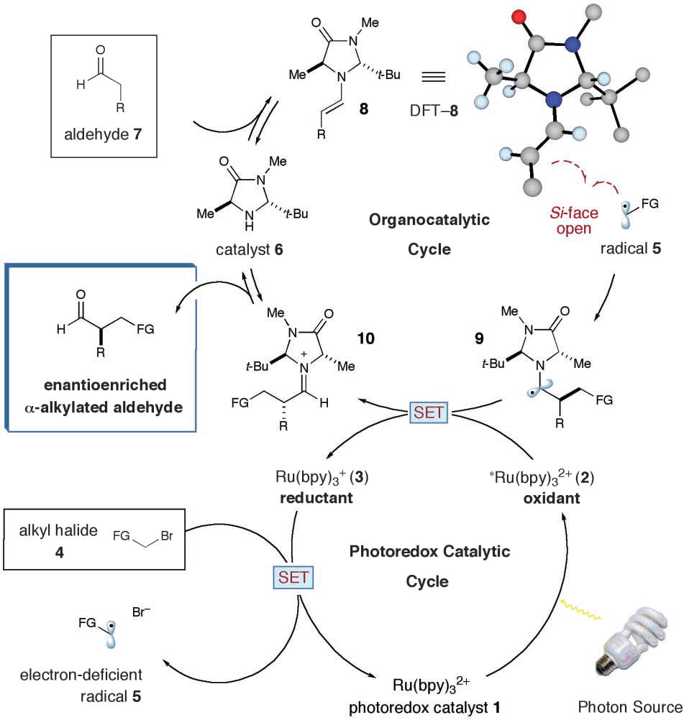
Excited State Electron Transfer
Photocatalytic α-alkylation of aldehydes
Nicewicz, D. A.; MacMillan, D. W. C. Science 2008, 322, 77-80.

Slide 39
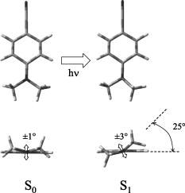
Excited State Structural Change
Twisted Intramolecular Charge Transfer
e⁻
e⁻
Pratt et al. J. Chem. Phys. 2005, 122, 084309

Slide 40


Excited State Structural Change
Excited State Proton Transfer
ESIPT
absorption
reverse proton transfer
emission

Slide 41
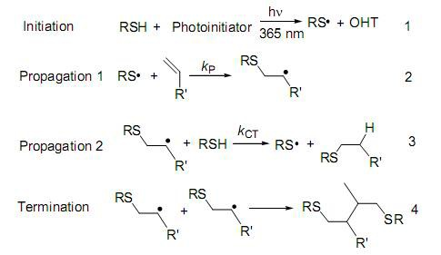
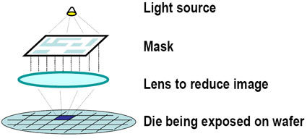
Photochemical Reactions
Photopolymerization

Slide 42
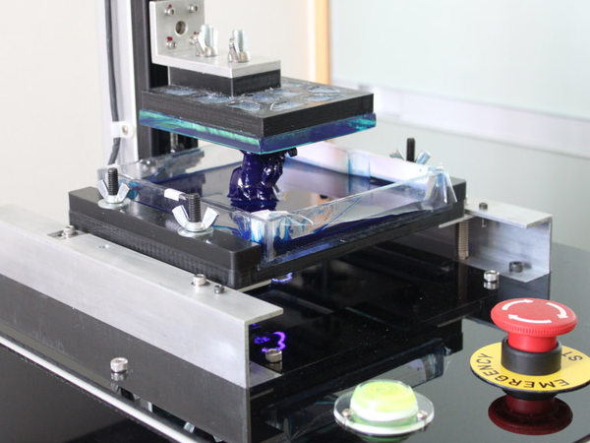
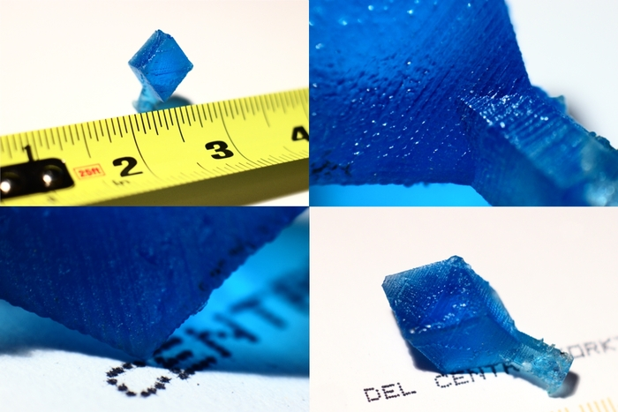
Photochemical Reactions
Photopolymerization
3-D Printers

Slide 43
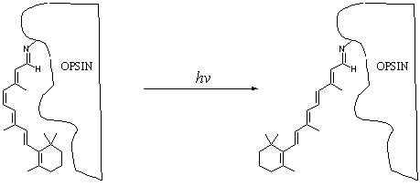
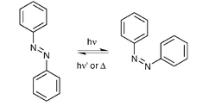
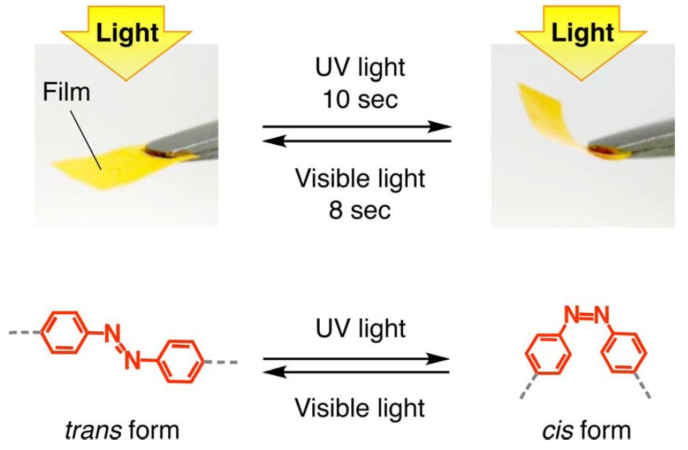
Photochemical Reactions
Photoisomerization
hν
Ground State
Excited State

Slide 44
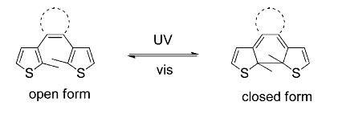
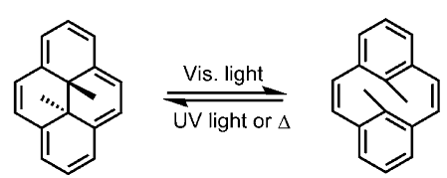
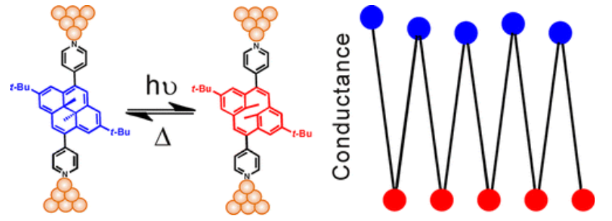
Photochemical Reactions
Photoswitches
J. Am. Chem. Soc., 2013, 135 (16), pp 5974–5977

Slide 45
“Complete” Jablonski Diagram
S₂
Product
S₁
T₂
E
T₁
Product
S₀
Processes
Excitation
Fluorescence
Phosphorescence
Non-radiative decay
Internal conversion
Intersystem crossing
Photochemistry
Measurement Technique
Absorption Spectroscopy
Fluorescence Spectroscopy
Transient Absorption Spectroscopy

Slide 46






Side Note: Other Excitations
Thermal Excitation

Slide 47





Side Note: Other Excitations
Chemical Excitation

Slide 48



Side Note: Other Excitations
Sonoluminescence

Slide 49





Side Note: Other Excitations
  Tribo/Fractoluminescence
Nature 2008, 455, 1089–1092.

Slide 50




Side Note: Other Excitations
  Electroluminescence

Slide 51







Any questions?
Follow us on Twitter and Instagram (@HansonFSU)

